Slide 1




Negative effects of an allelopathic invader intensify as the growth season progresses
Evan A. Perkowski, K. Carroll, Jessie Mutz, Snehanjana Chatterjee, Xianyu Yang,
Lalasia Bialic-Murphy, Stephanie N. Kivlin, Susan Kalisz, Nicholas G. Smith

Slide 2
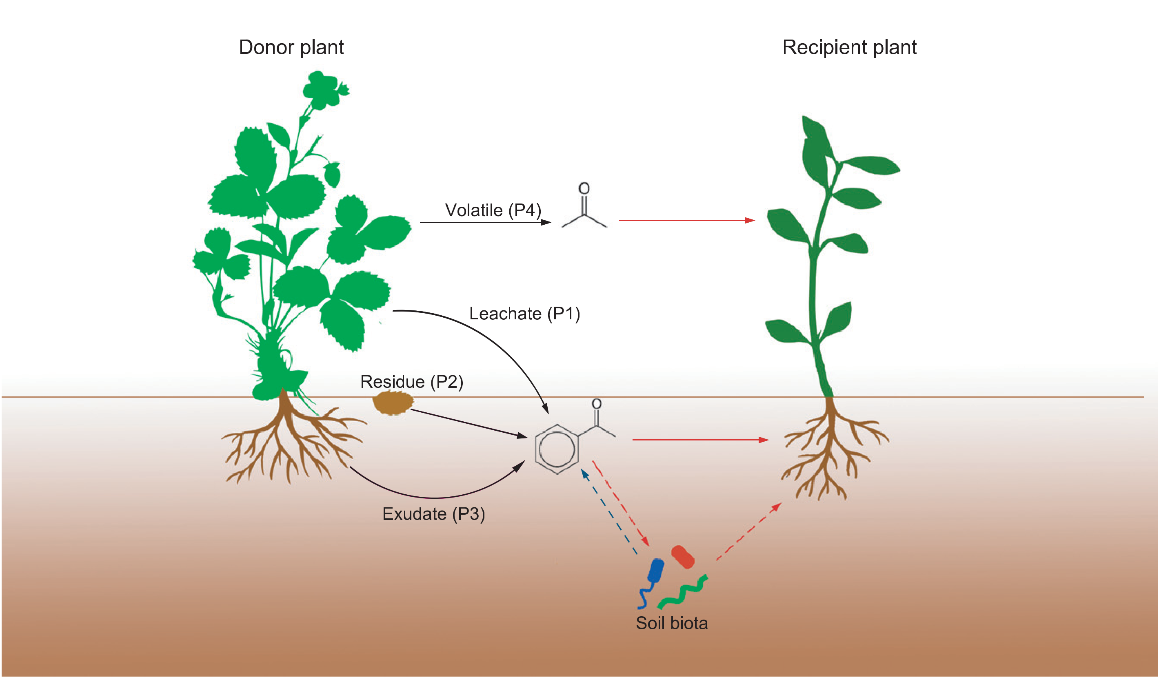
Allelopathy negatively affects neighboring plants through multiple pathways
Zhang et al. (2020) Ecology Letters
Notes:
Allelopathy is described as a secondary compound produced by a plant that negatively affects neighboring plant species or soil microbial communities.
Plants can induce allelopathic effects on neighboring species through multiple pathways, such as the release of volatile compounds, leaf litter, or root exudates
Leaf litter and root exudates can impact neighboring plant communities through direct phytotoxic effects,
or through indirect antimicrobial effects on soil microbial communities that alter plant ability to take in nutrients and water needed to grow and reproduce

Slide 3
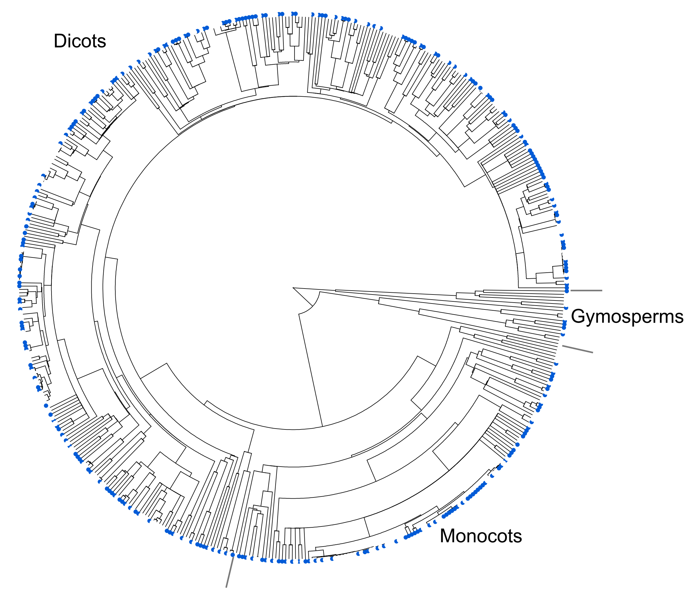
Allelopathy is pervasive in invasive plant species
52% of surveyed invasive
species (72% of families) exhibit
allelopathic capabilities!
allelopathic invasive species
non-allelopathic invasive species
Kalisz et al. (2021) Biological Invasions
Notes:
Allelopathy is a key trait associated with plant invasions
A recent study found that 72% of surveyed plant families and 52% of surveyed invasive species possess allelopathic capabilities.
These species were surveyed across a diverse phylogeny and was observed in monocots, dicots, and gymnosperm groups.
This suggests that allelopathy is pervasive in invasive plant species

Slide 4
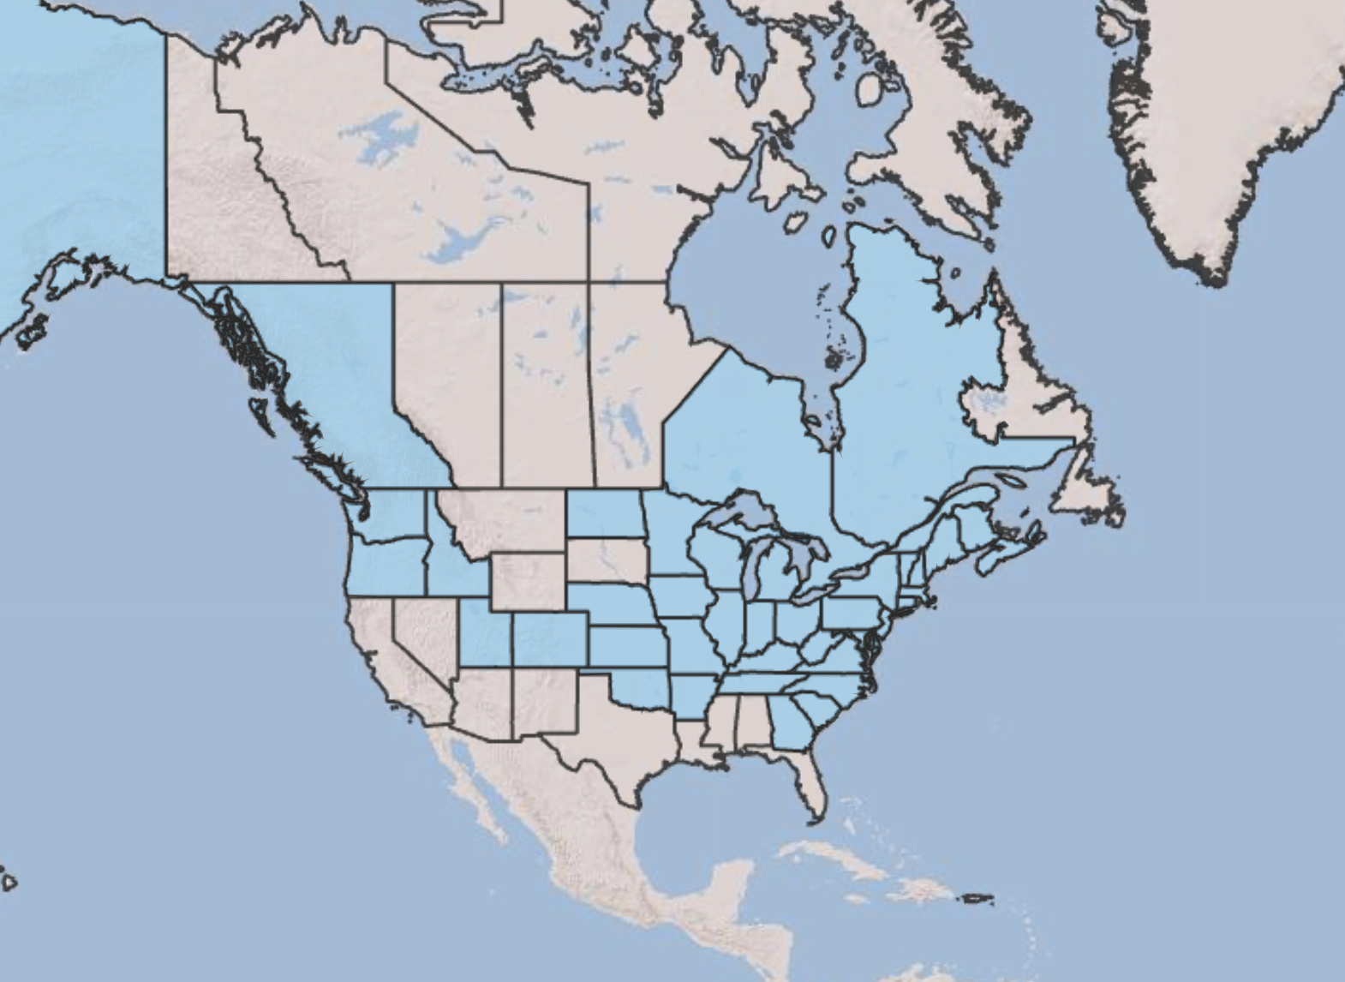
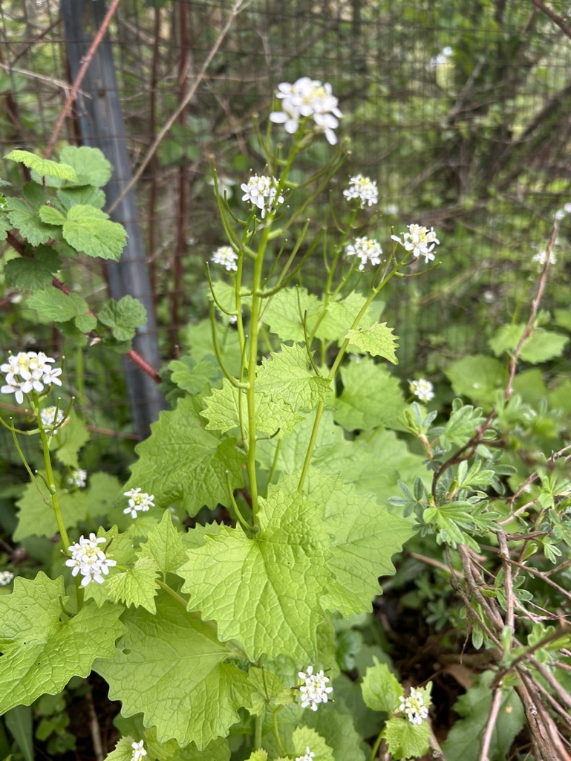
Garlic mustard (Alliaria petiolata, Brassicaceae) is a widespread allelopathic invader in North America
Invades understories of forests in the eastern half of North America
Biennial herb with two life forms
Non-mycorrhizal (acquires nutrients exclusively through direct root uptake)
USDA Plants Database
Notes:
One common and well-studied model species for studying effects of allelopathic plant invasion on coexisting native species is garlic mustard

Slide 5
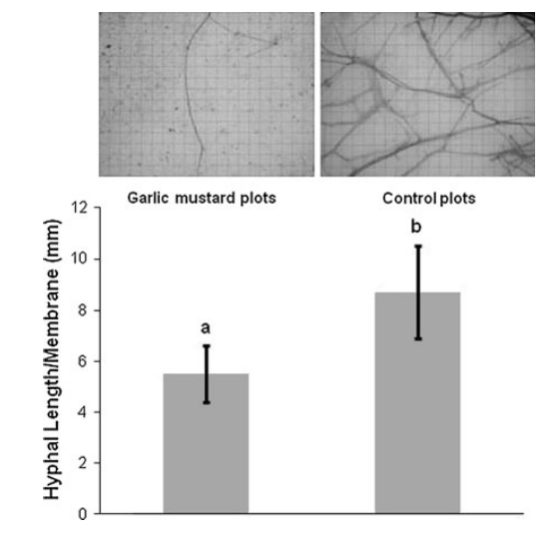
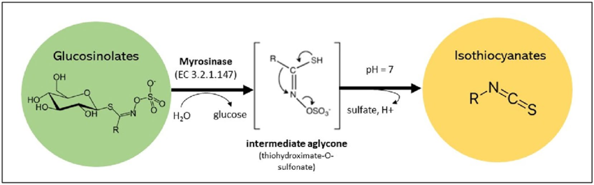
Garlic mustard allelochemicals have deleterious effects on AM fungal communities
Isothiocyanates kill AM spores and reduce AM root colonization, hyphal growth, and arbuscule formation
Cantor et al. (2011) Biological Invasions
Notes:
Garlic mustard releases glucosinolates into soils through leaf litter or root exudation.
Upon release into soil solution, glucosinolates hydrolyze into isothiocyanates, which kill AM fungal spores, reduce AM fungal growth, and likely decrease the strength of their symbiosis with plant roots

Slide 6
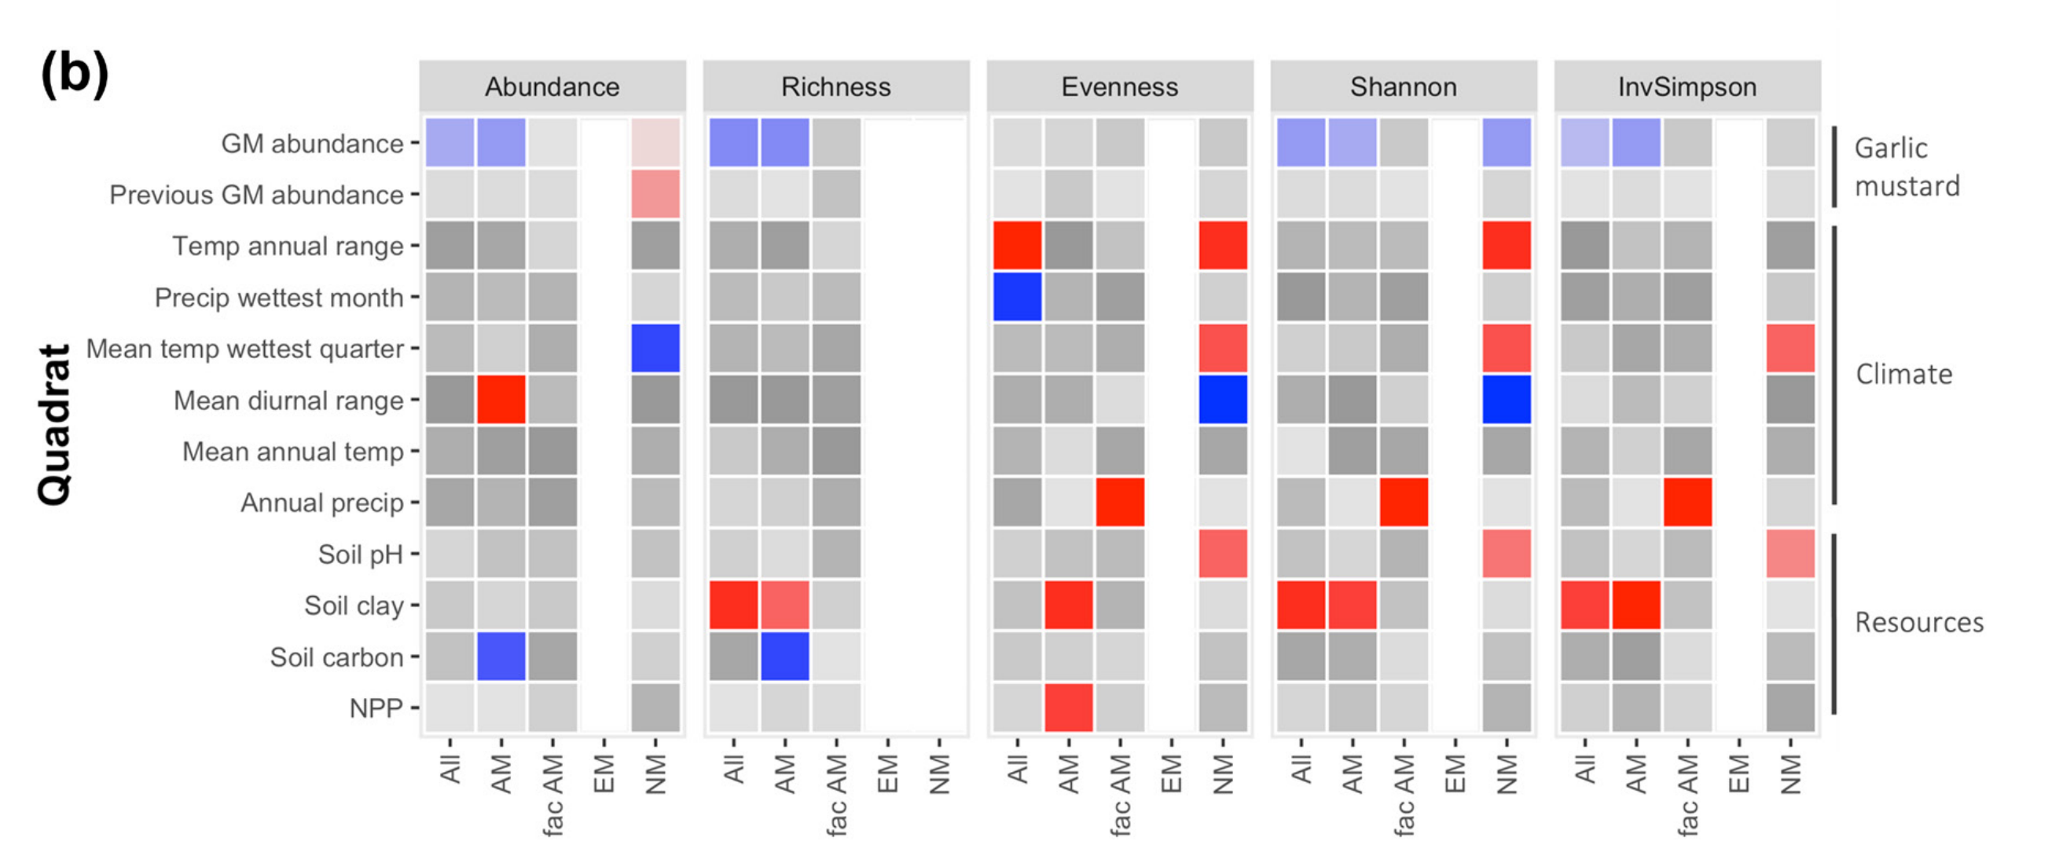
Garlic mustard decreases native plant community diversity
Negative effect
Positive effect
Roche et al. (2023) Ecography
Notes:
Garlic mustard has also been shown to negatively affect plant community composition.
A recent study found that garlic mustard decreased native plant species abundance and richness, which decreased two indices of community diversity

Slide 7
Garlic mustard decreases native plant community diversity
Negative effect
Positive effect
Roche et al. (2023) Ecography
Notes:
It is worth noting that these patterns were largely driven by reduced abundance and richness in native plants that associate with AM fungi

Slide 8
AM fungal and plant community responses to garlic mustard invasion may be linked
AM fungal community form and function
Garlic mustard
Native plant community form and function
Predicted negative effect
Notes:
This suggests that disrupted AM fungal symbioses due to garlic mustard invasion are likely the cause of these changes to native plant community structure
The fact that reduced plant community diversity is only observed in species that associate with AM fungi suggest that these patterns might be linked
Photosyntehtic traits may be first indicators of AM fungal disruption due to garlic mustard invasion

Slide 9
To understand these linkages, we must understand native species’ physiological responses to garlic mustard
AM fungal community form and function
Garlic mustard
Native plant physiology
Native plant community form and function
Predicted negative effect
Notes:
However,

Slide 10
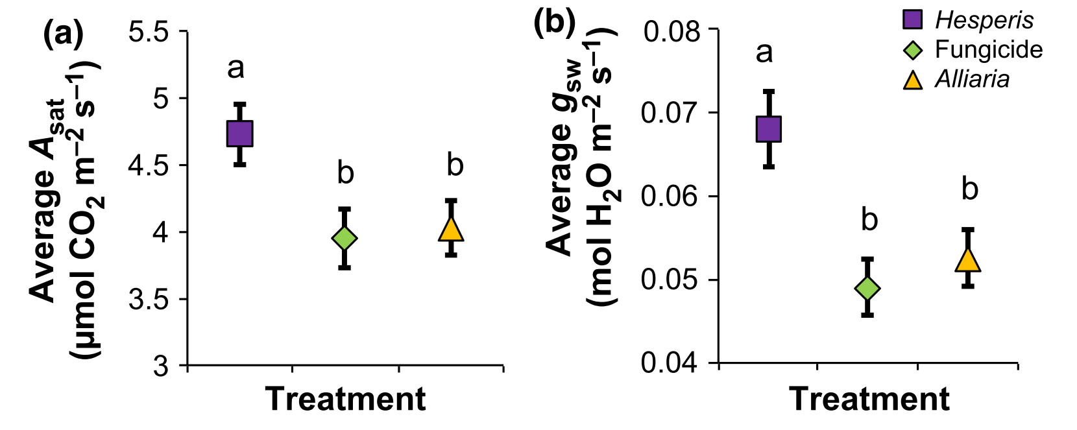
Previous work shows that garlic mustard decreases native species net photosynthesis and stomatal conductance
Hale et al. (2016) New Phytologist

Slide 11
Open questions
What mechanisms drive native species’ photosynthetic responses to garlic mustard invasion?
Do native species’ responses to garlic mustard invasion vary due to seasonality?
Notes:
But, these are only snapshot measurements and more work is needed to understand the mechanisms that drive these responses
Additionally, previous work has measured these responses at a single timepoint during the growth season
Temperate forest understories are dynamic, with light availability decreasing as tree canopies close and nutrient availability decreasing as plants take them in
Thus, a central question remains as to whether effects of garlic mustard are consistent across the growth season or if they vary across the growth season

Slide 12
Hypotheses
Predicted positive effect
Predicted negative effect
Nutrient uptake
Photosynthetic capacity
Garlic mustard
AM fungal partner strength
Leaf-level carbon assimilation
Water uptake
Stomatal conductance

Slide 13
Hypotheses
Predicted positive effect
Predicted negative effect
Nutrient uptake
Photosynthetic capacity
Garlic mustard
AM fungal partner strength
Leaf-level carbon assimilation
Water uptake
Stomatal conductance
Negative effects of garlic mustard
may be strongest early in growth season when leaf nutrient demand is greatest
Negative effects of garlic mustard
may be strongest later in growth season when resource availability is depleted

Slide 14
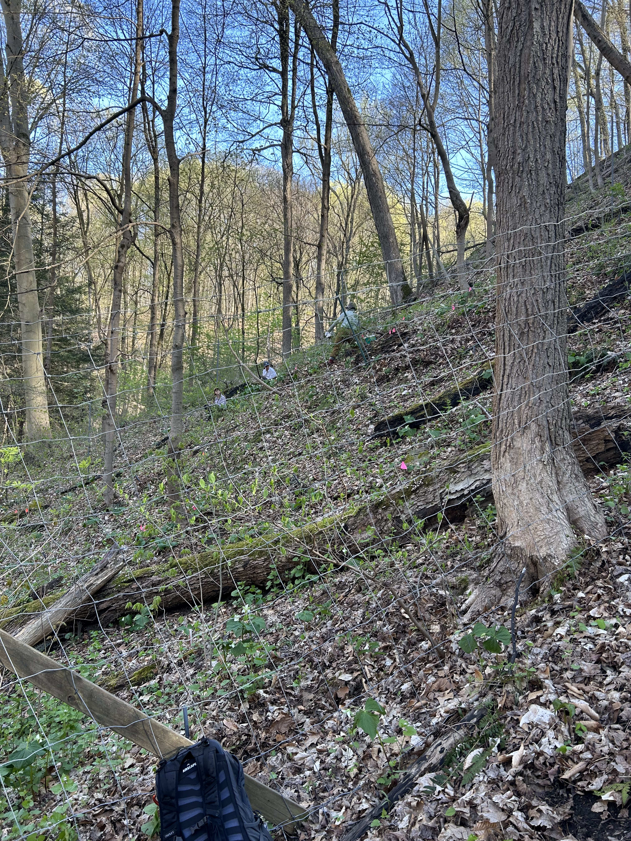
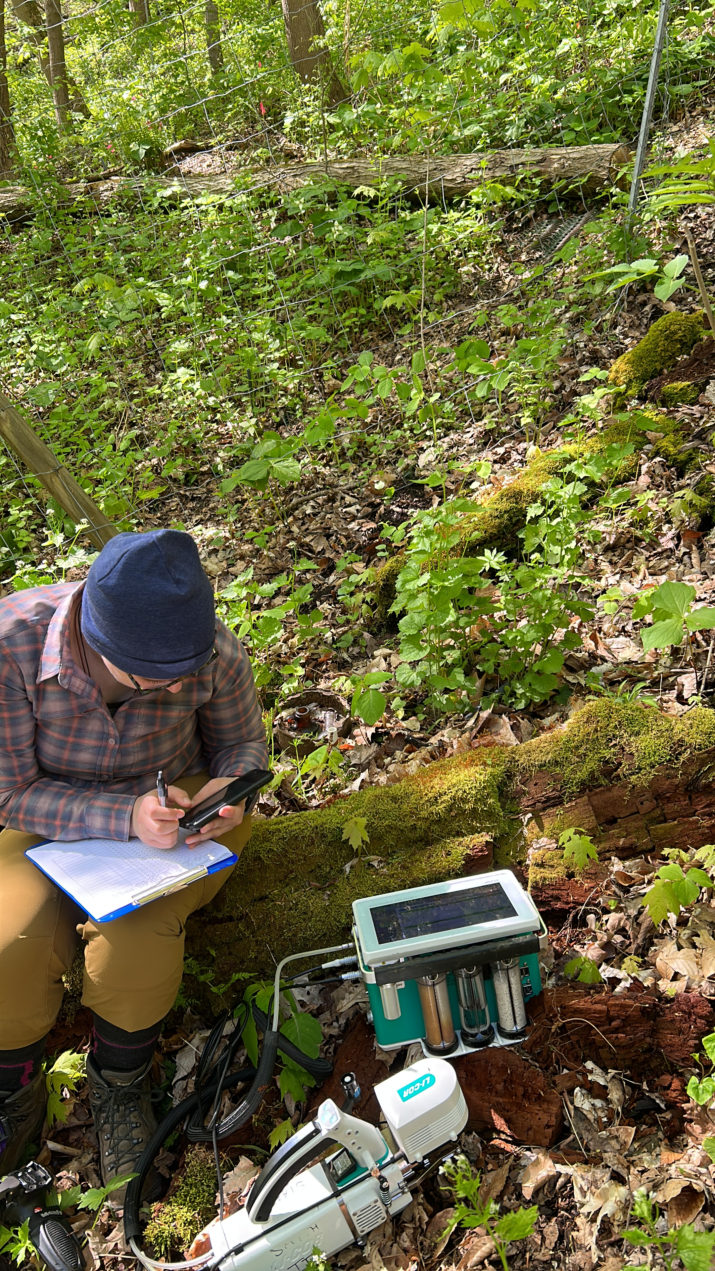
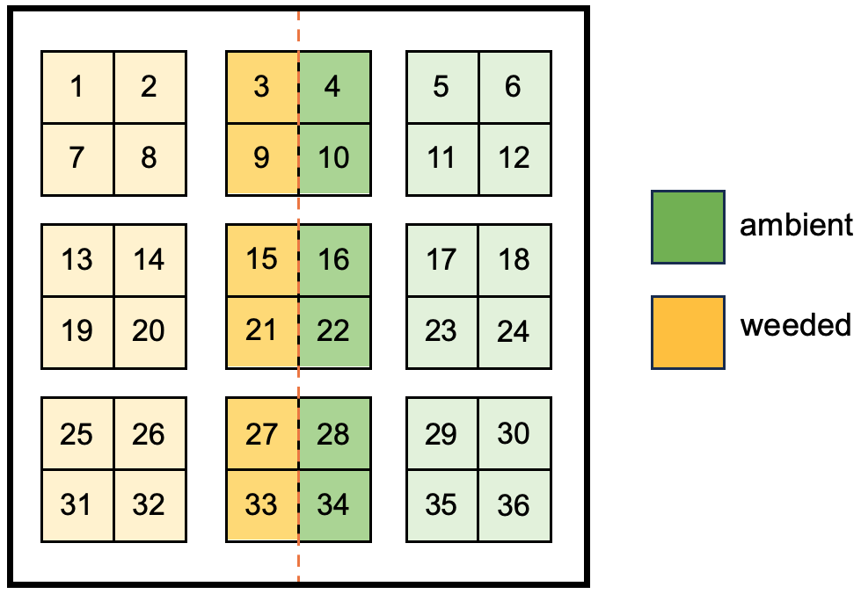
Long-term Alliaria weeding experiment
Located in Fox Chapel, PA
Fencing established in 2002 to ward out deer/macro-herbivores
Garlic mustard weeding treatments began in 2006
Split plot design

Slide 15
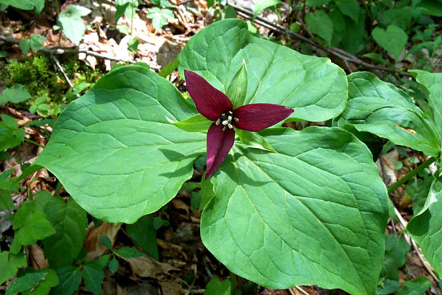
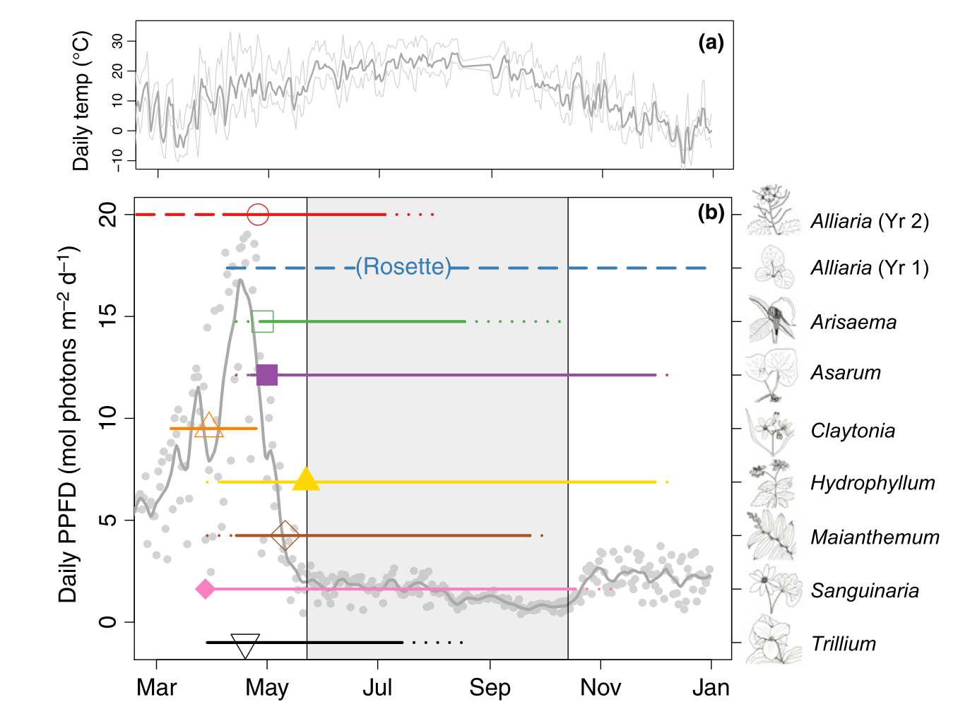
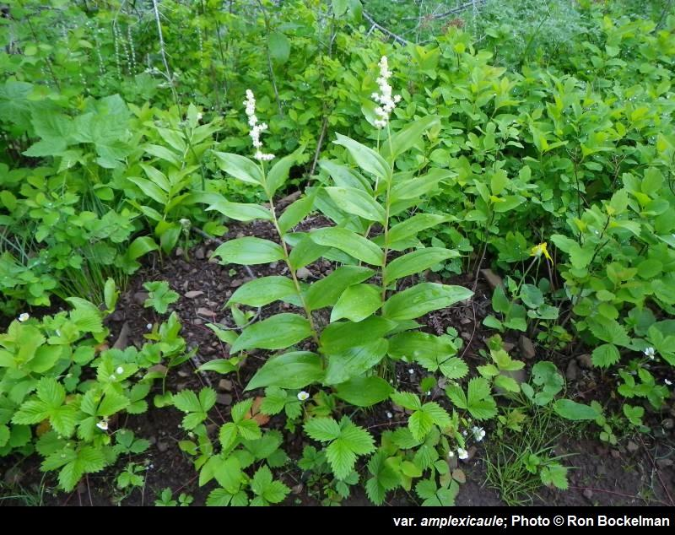
Focal species
Trillium spp.
Maianthemum racemosum
Heberling et al. (2019) New Phytologist

Slide 16
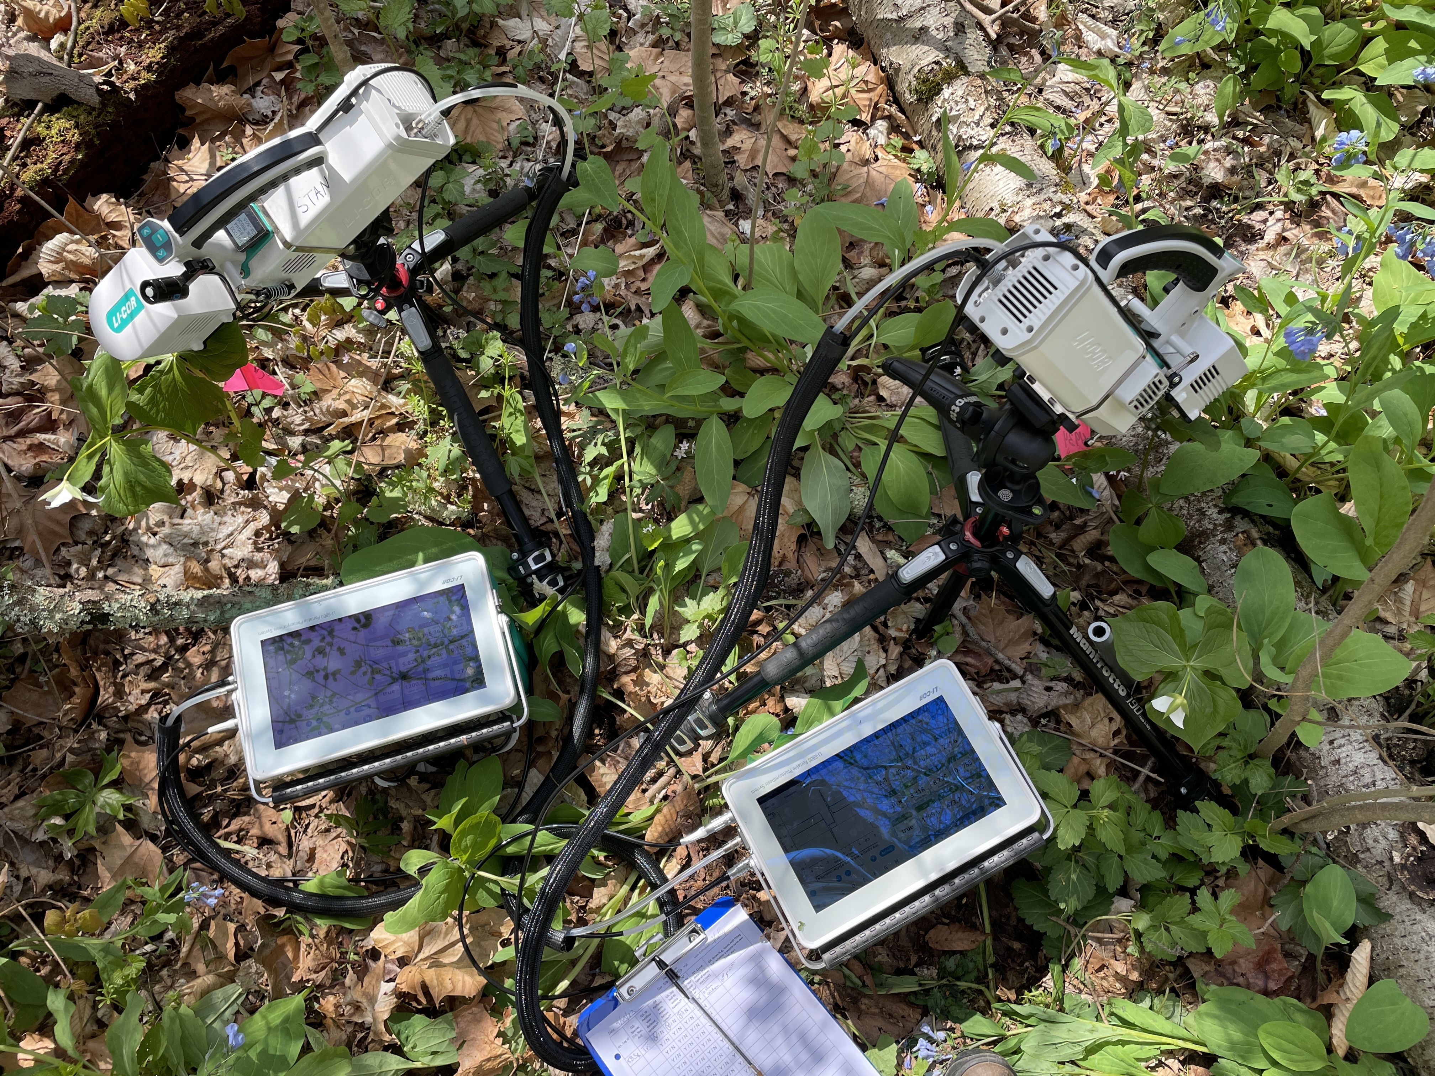
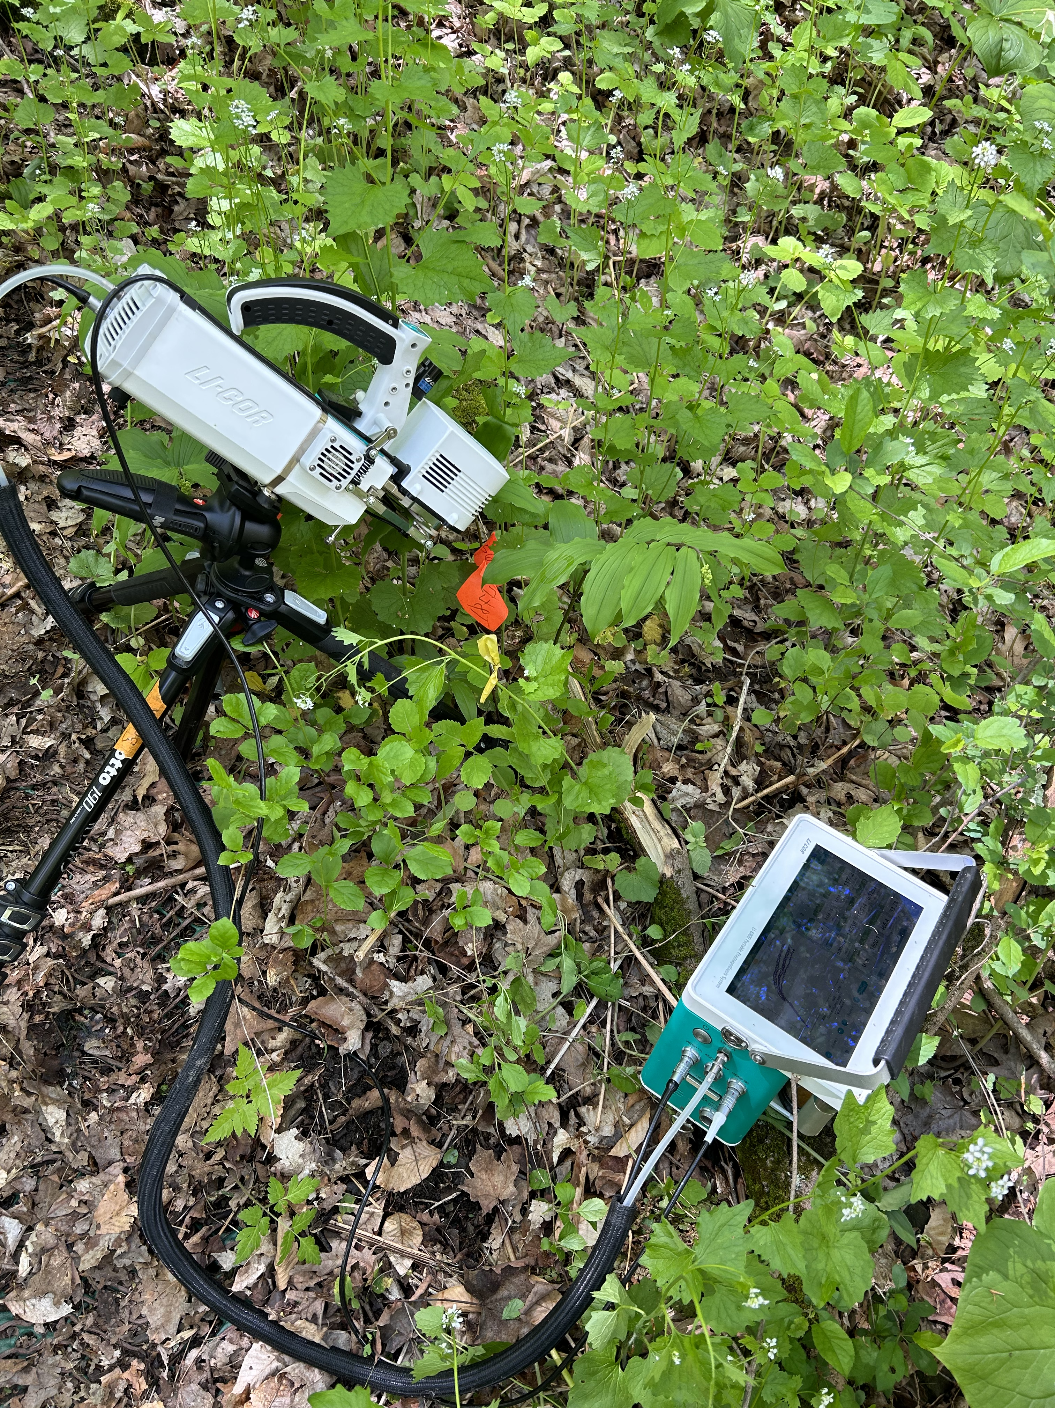
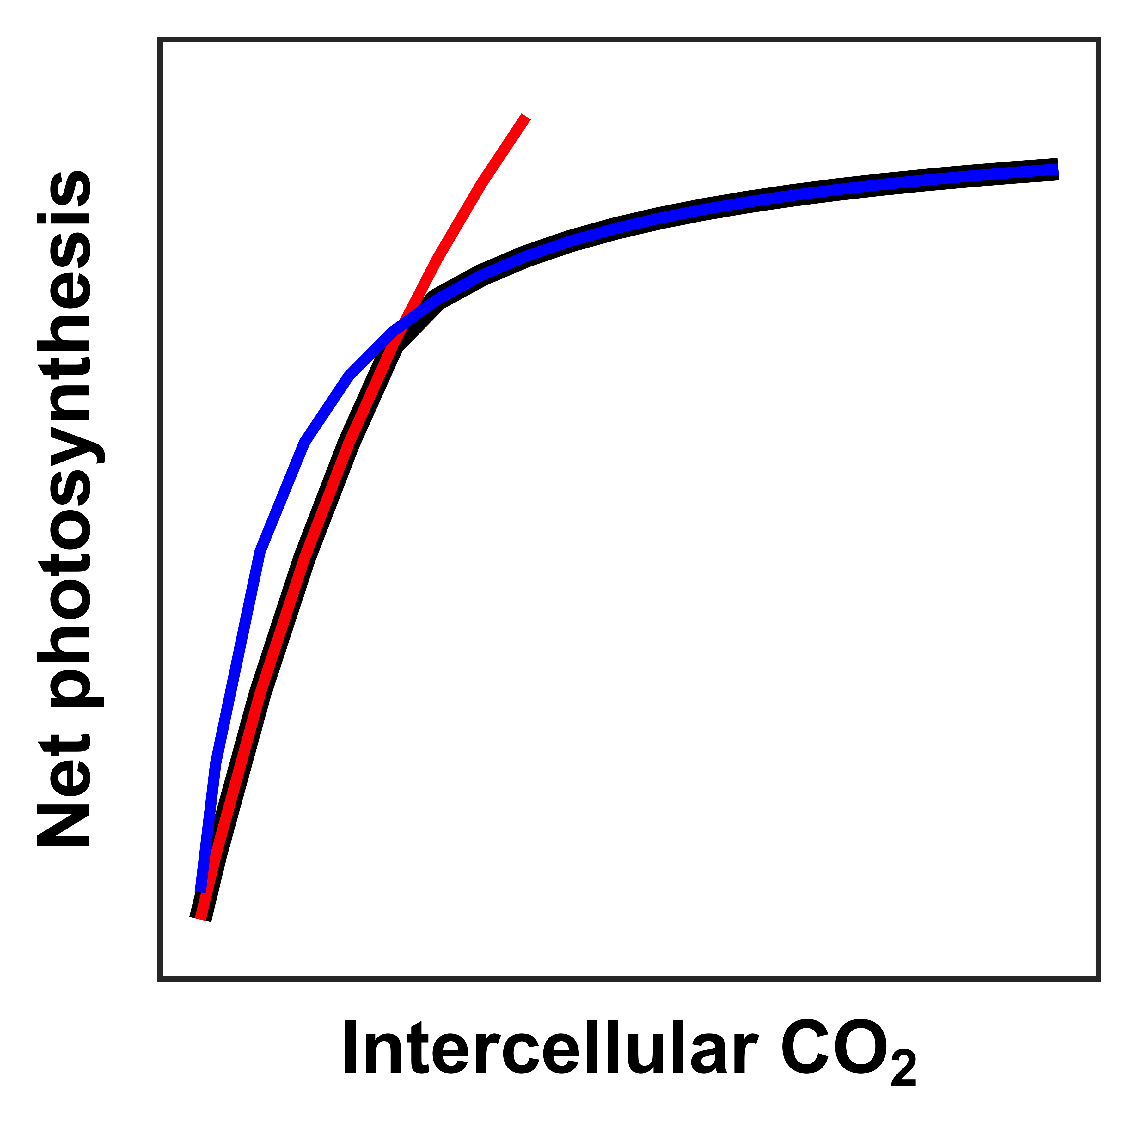
Field measurements
Soil resin sticks
Inorganic nitrogen and phosphate availability
CO₂ response curves
Maximum rate of Rubisco carboxylation (V_{cmax})
Maximum rate of electron transport for RuBP regeneration (J_{max})
Snapshot gas exchange measurements
x 2 measurement periods (open, closed tree canopy)

Slide 17
Gas exchange measurements were collected at two time points
second measurement period (closed tree canopy)
Heberling et al. (2019) New Phytologist
first measurement period (open tree canopy)

Slide 18
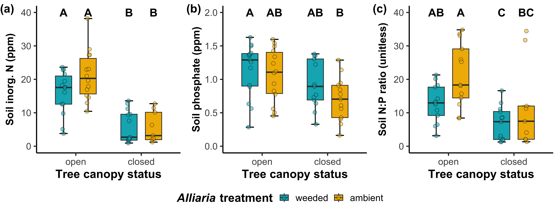
Garlic mustard does not affect soil nutrient availability

Slide 19
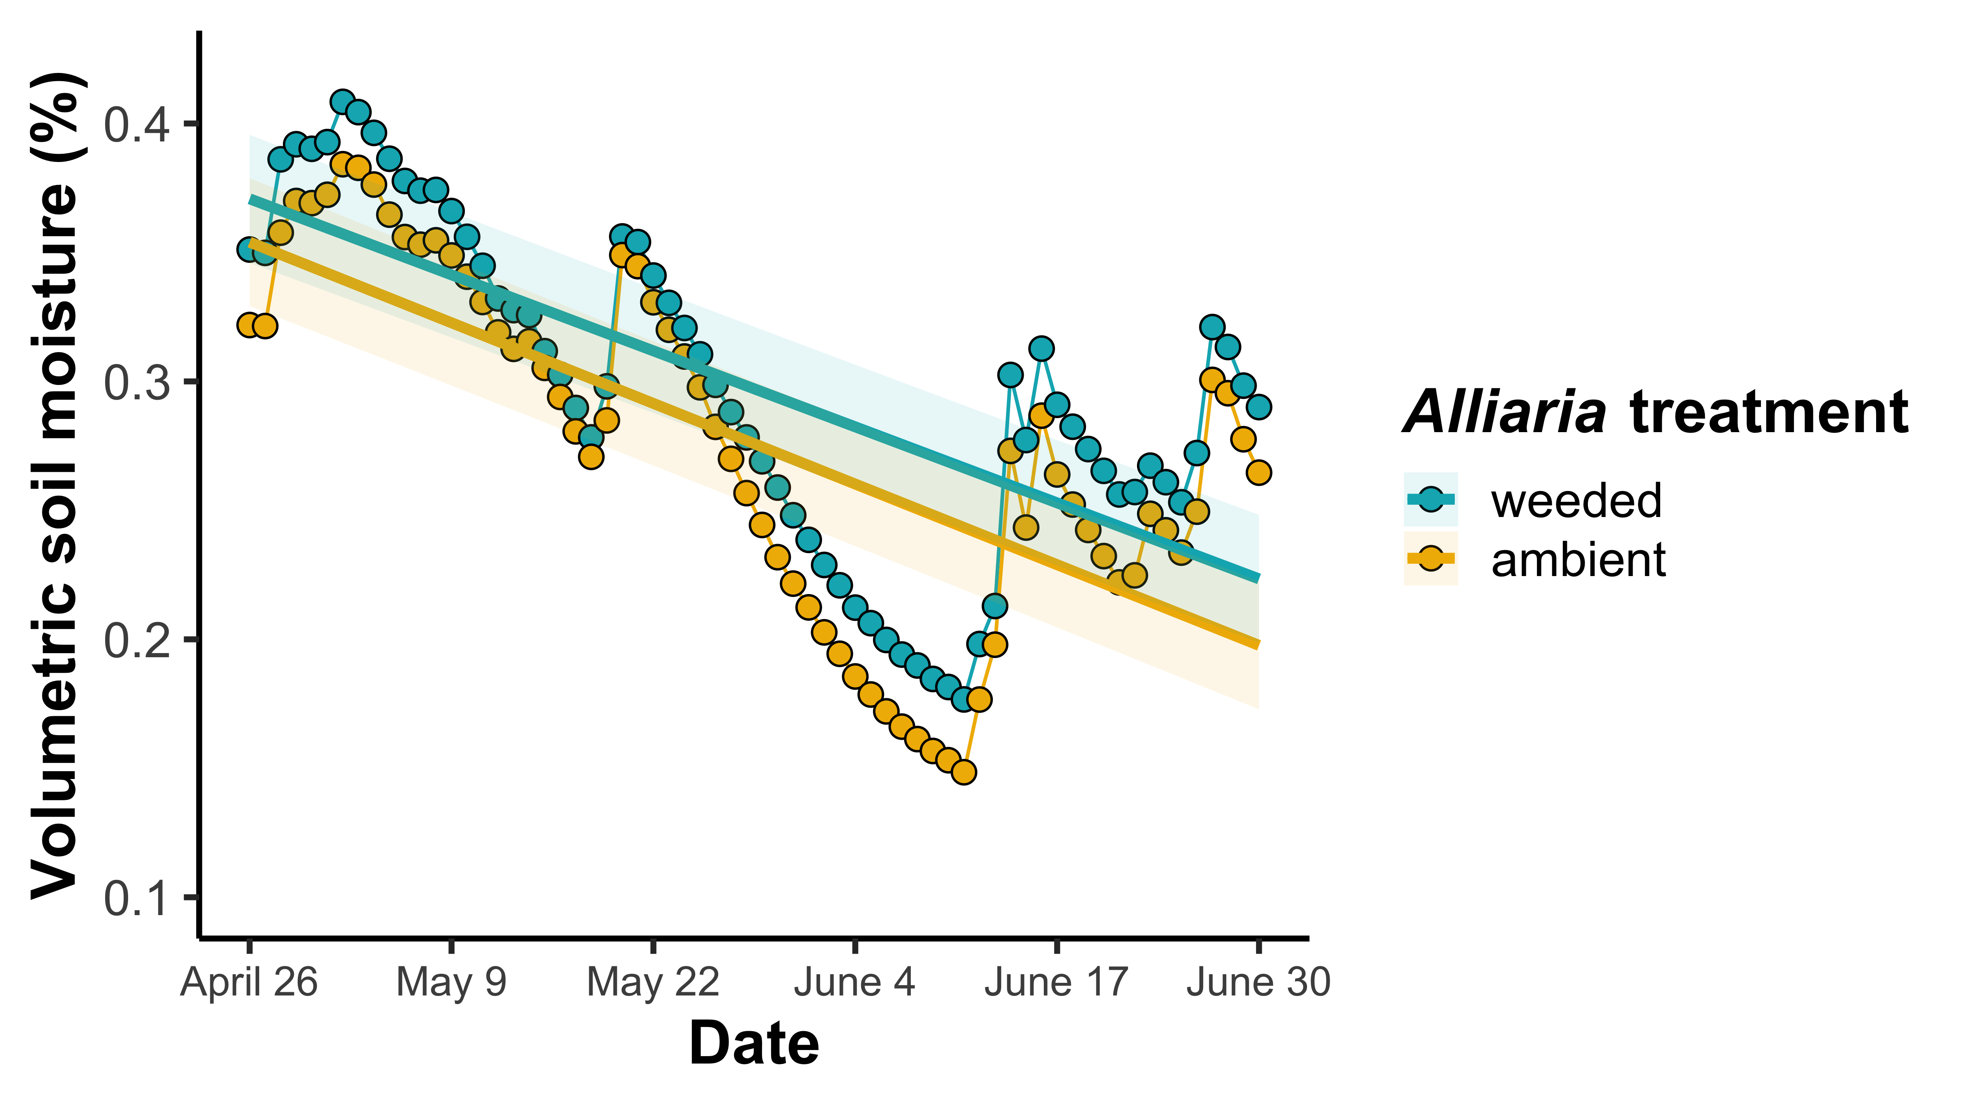
Alliaria is associated with reduced volumetric soil moisture

Slide 20
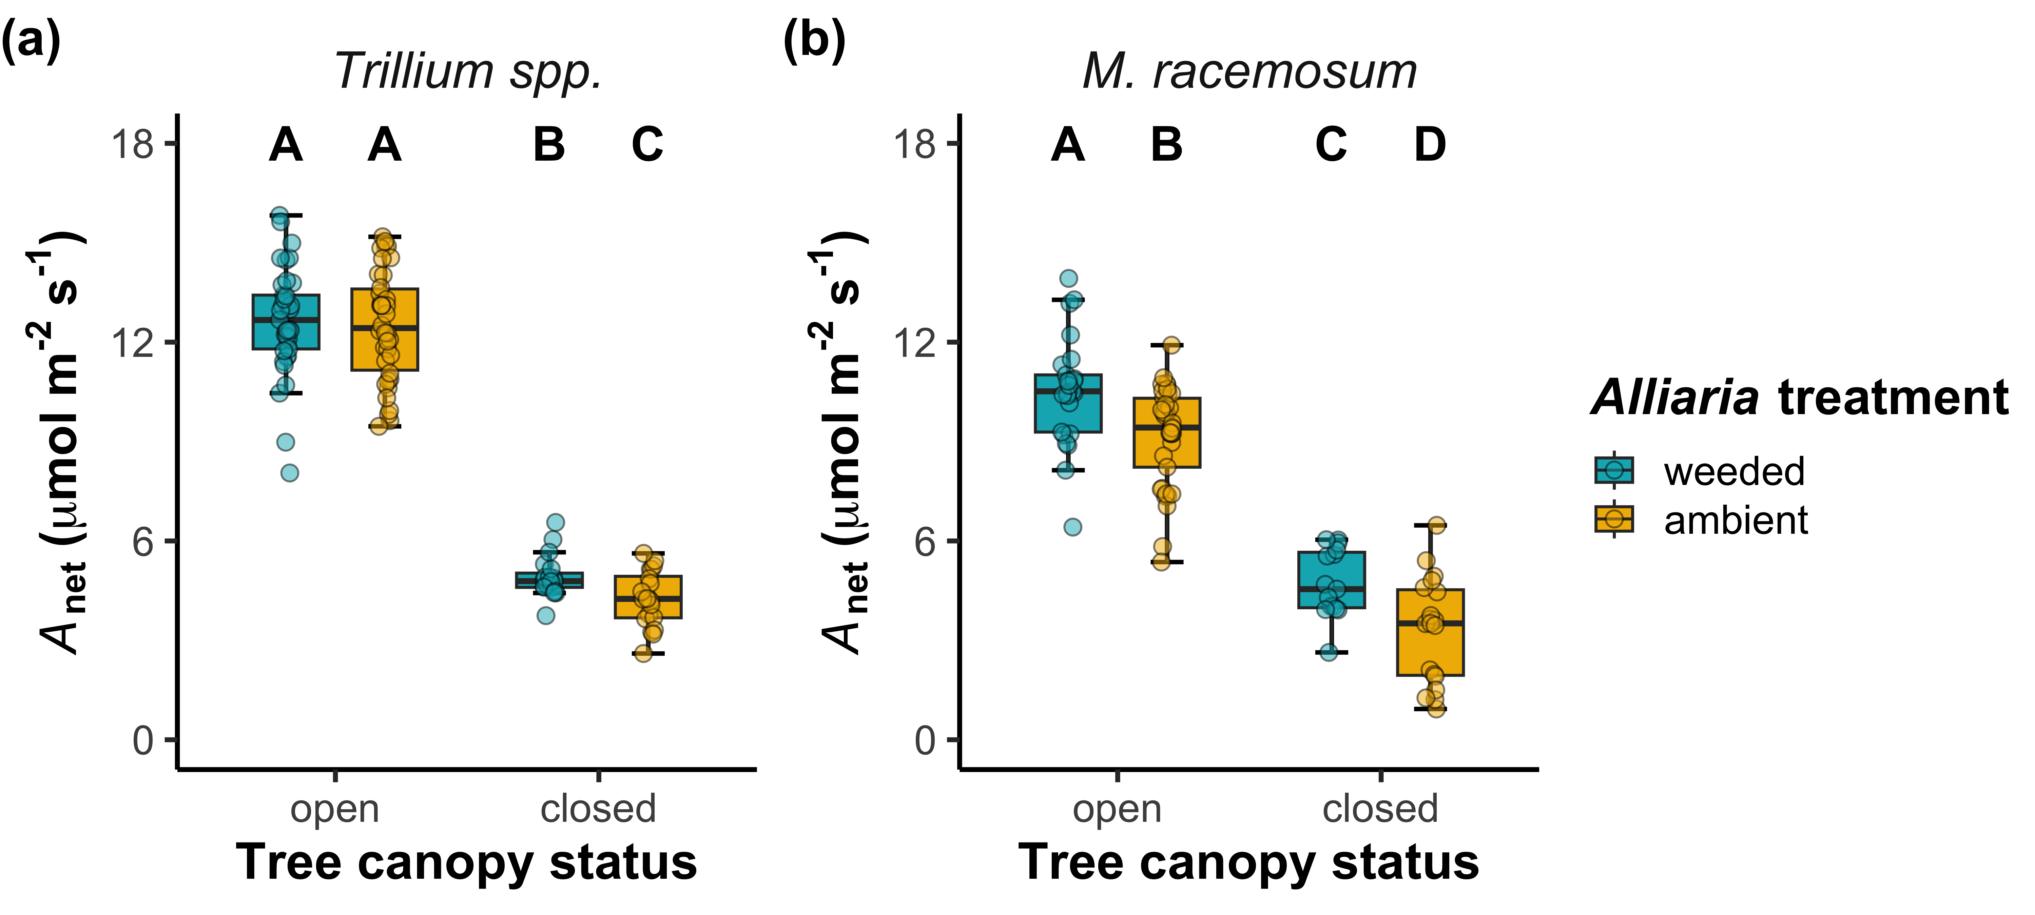
Alliaria decreased net photosynthesis rates in both species

Slide 21
Alliaria decreased net photosynthesis rates in both species*
*stronger negative effects of Alliaria presence in both species after tree canopy closure

Slide 22
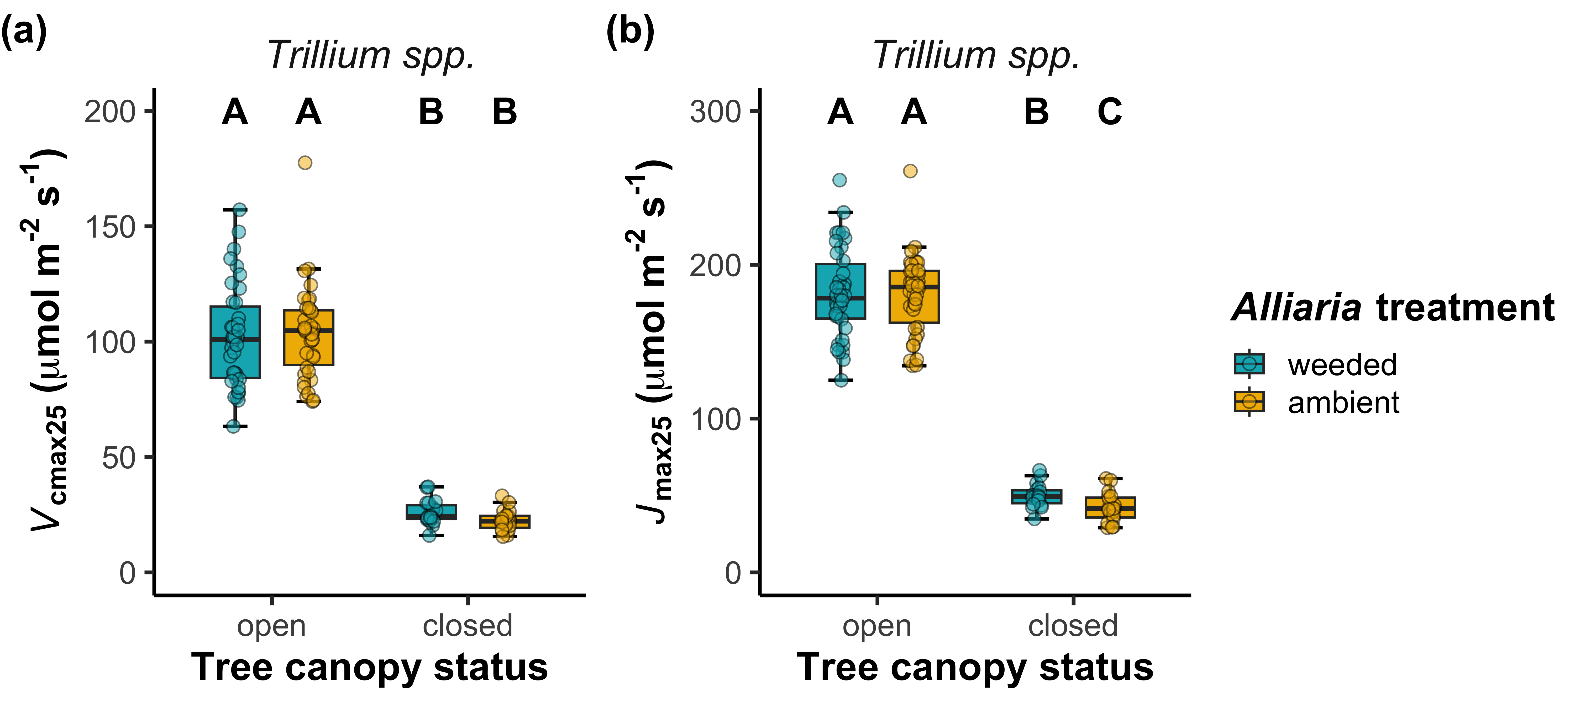
Photosynthetic responses to Alliaria in Trillium spp. were driven by changes to photosynthetic capacity
Notes:
Just show jmax
Mention that gsw and stomlim exhibit null responses

Slide 23
Photosynthetic responses to Alliaria in Trillium spp. were driven by changes to photosynthetic capacity*
*stronger negative effects of Alliaria presence on J_{max25} after tree canopy closure

Slide 24
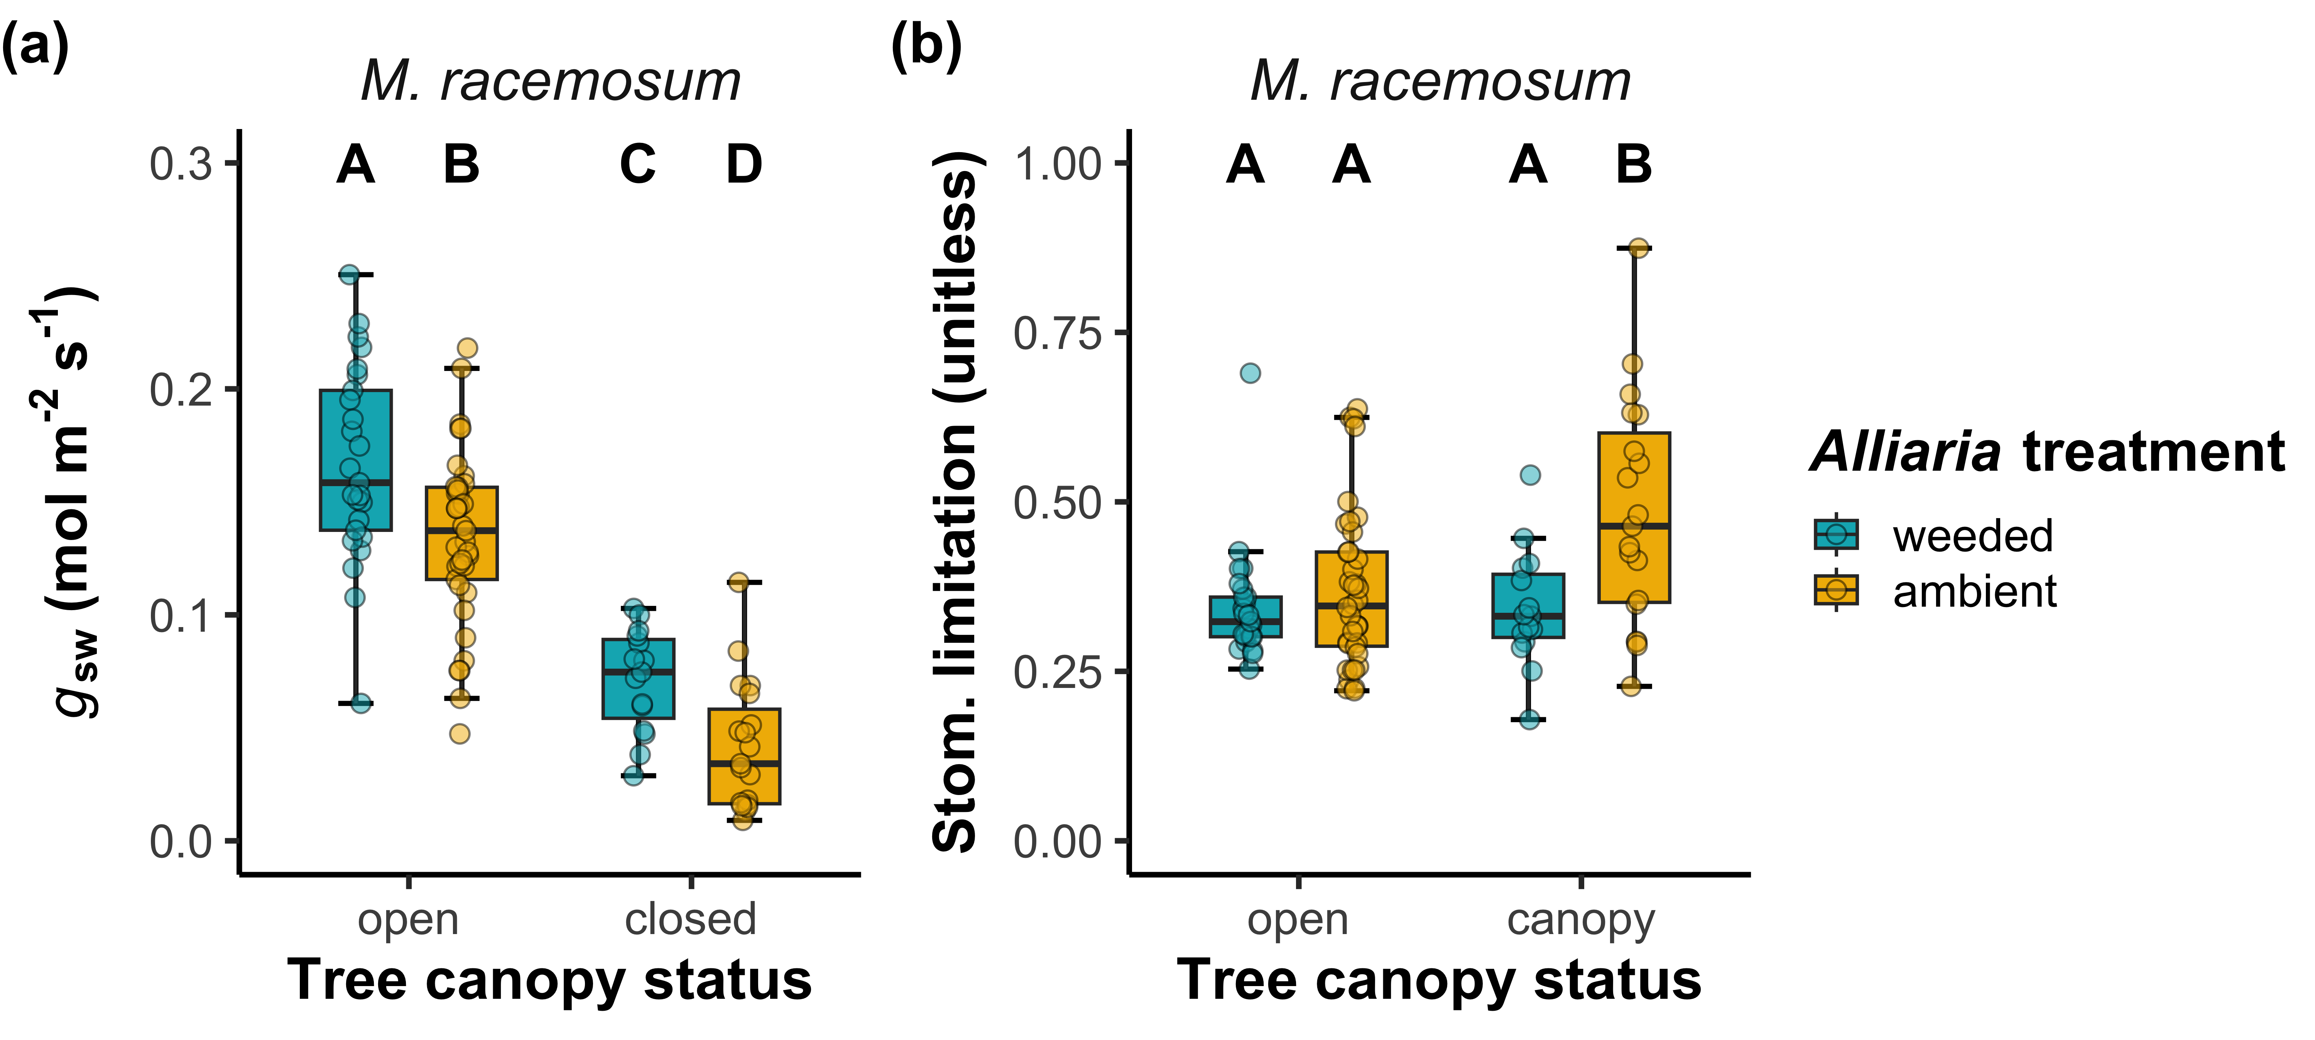
Photosynthetic responses to Alliaria in M. racemosum were driven by reduced stomatal conductance
Notes:
Just stomatal limitation

Slide 25
Reduced M. racemosum stomatal conductance increased stomatal limitation after tree canopy closure

Slide 26
Main takeaway #1: Alliaria decreased net photosynthesis in both species through species-specific mechanisms
Photosynthetic capacity
Photosynthetic capacity
Garlic mustard presence
Leaf-level carbon assimilation
Garlic mustard presence
Leaf-level carbon assimilation
Stomatal conductance
Stomatal conductance
Positive effect
Maianthemum
racemosum
Trillium spp.
Negative effect

Slide 27
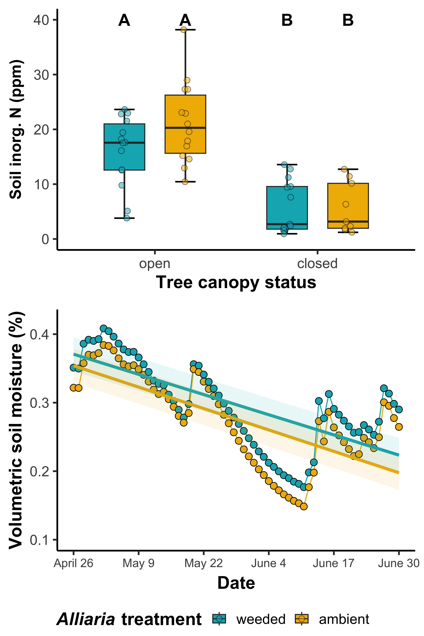
Main takeaway #2: Negative effects of Alliaria on leaf gas exchange intensified as the growth season progressed
Changes in resource availability may have increased reliance on disrupted AM fungal partners
Soil resources depleted as growth season progressed
Alliaria presence was associated with reduced volumetric soil moisture

Slide 28
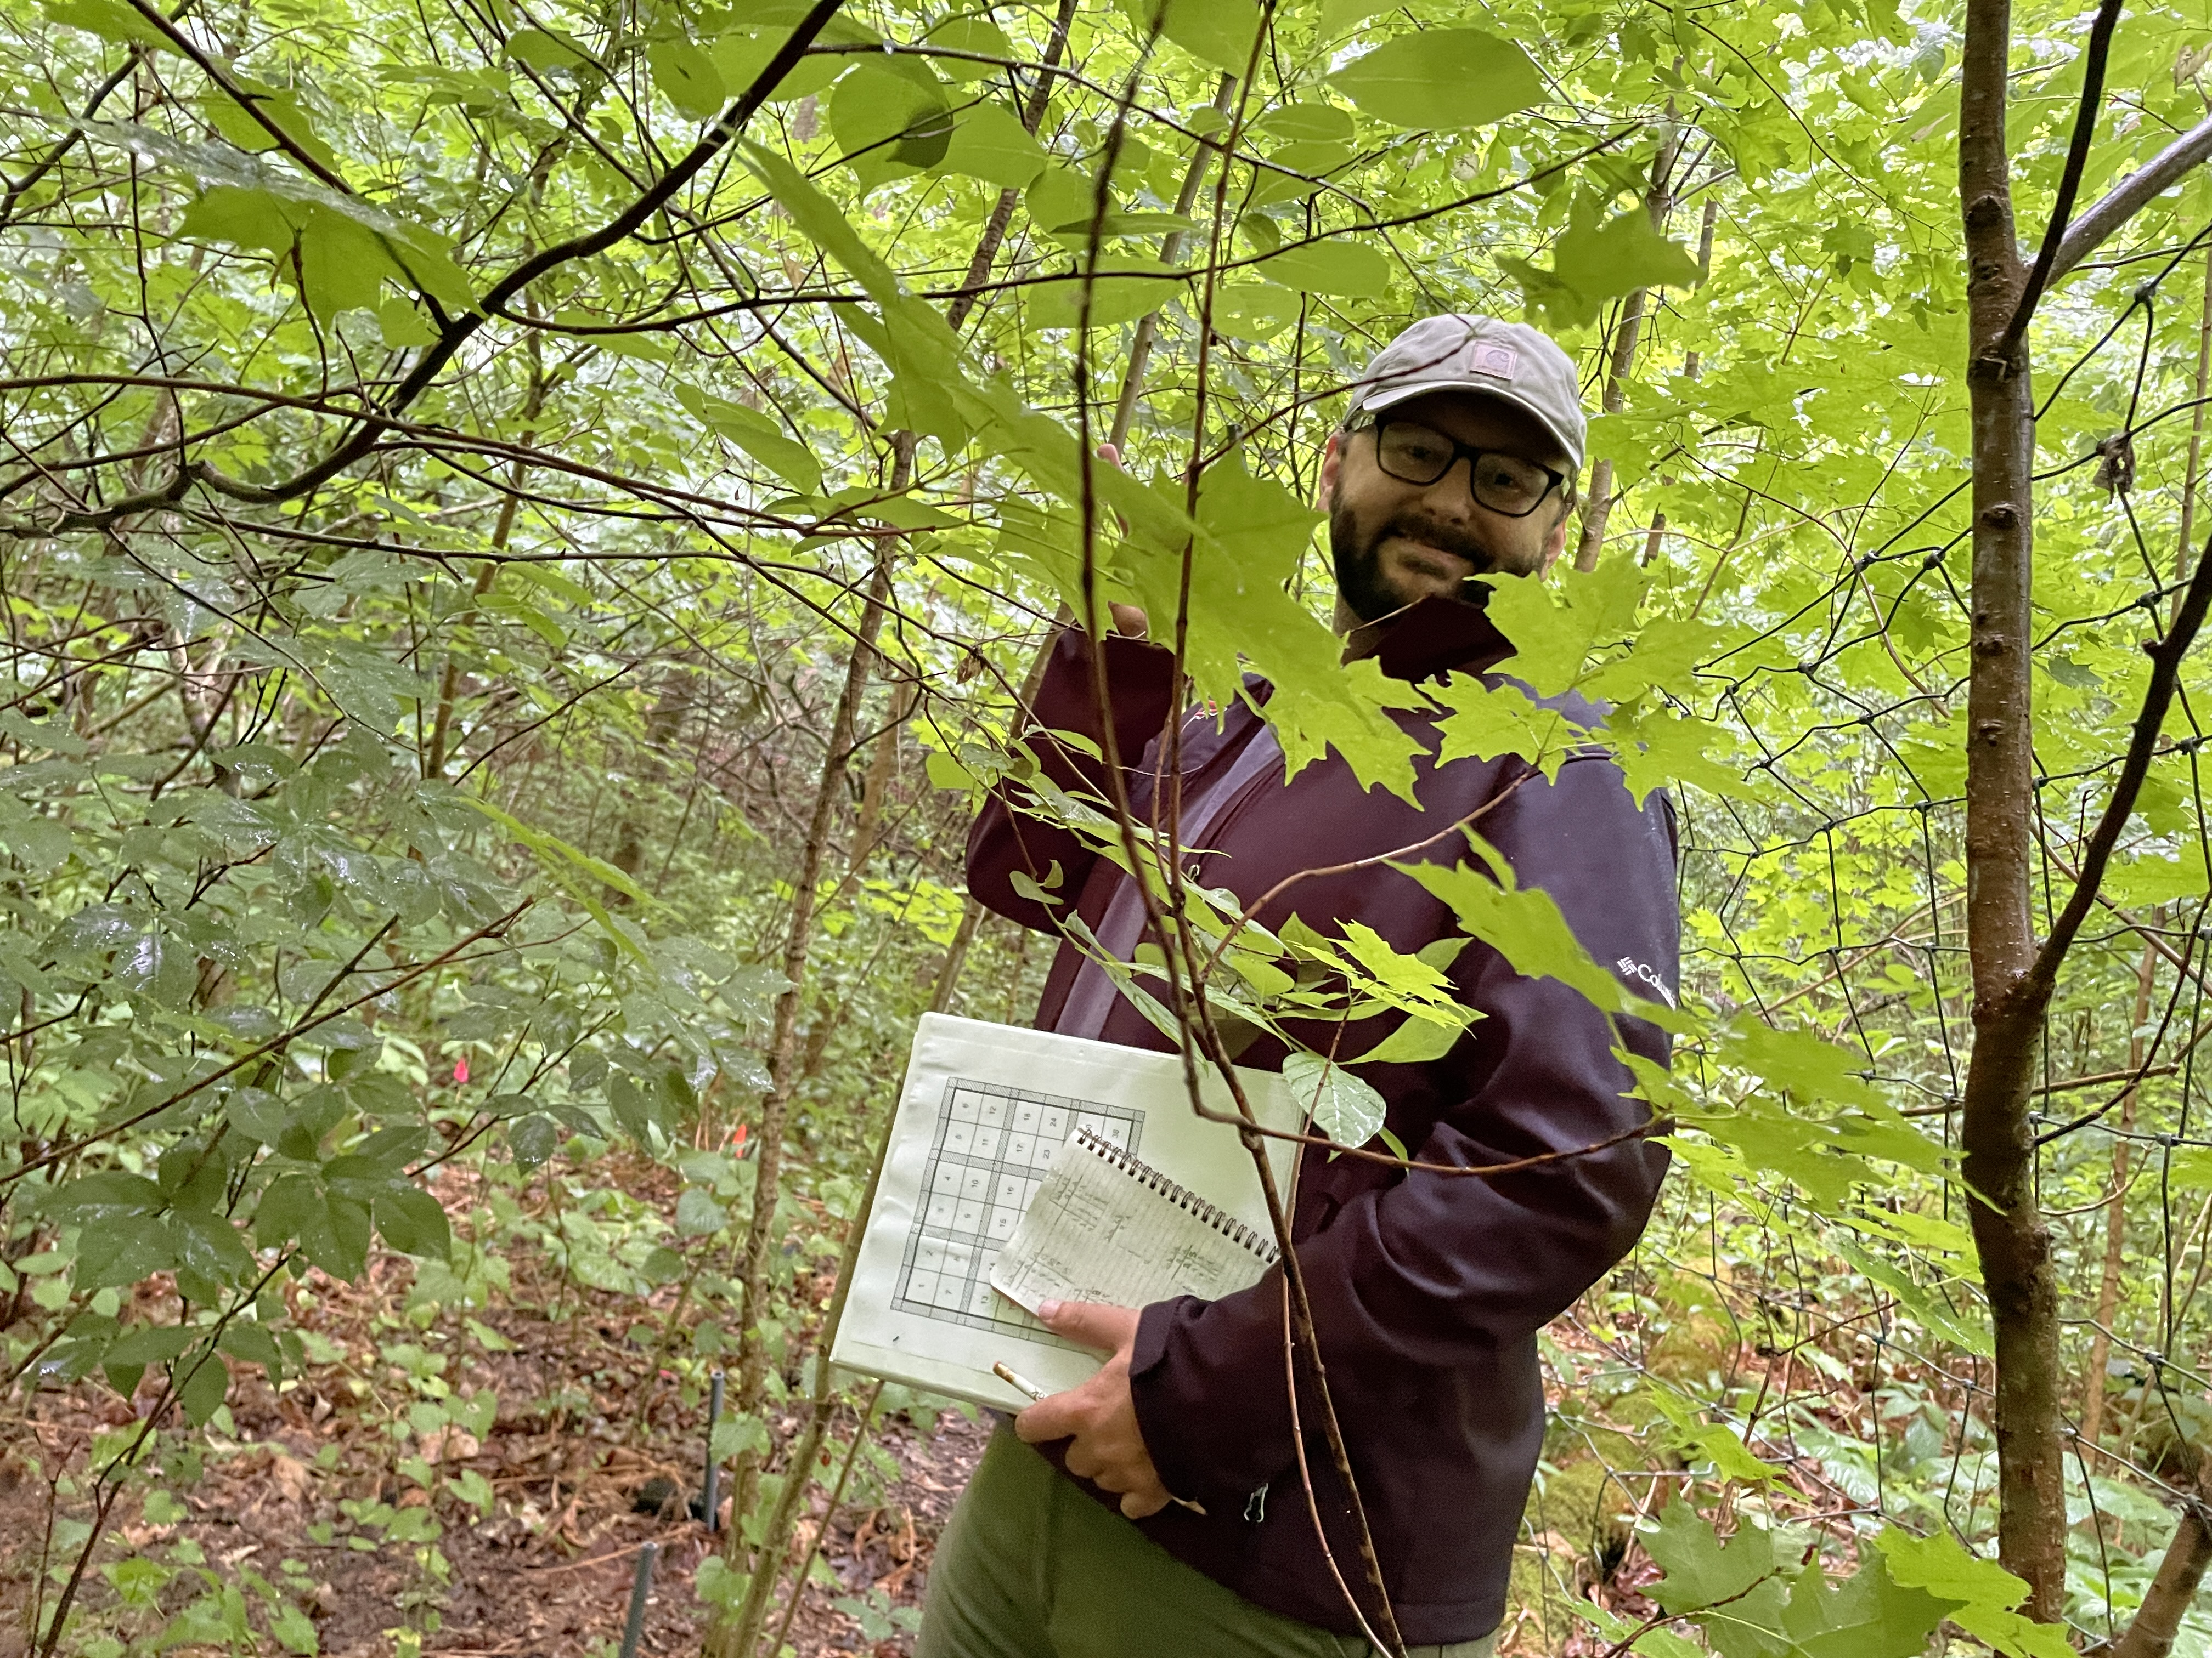
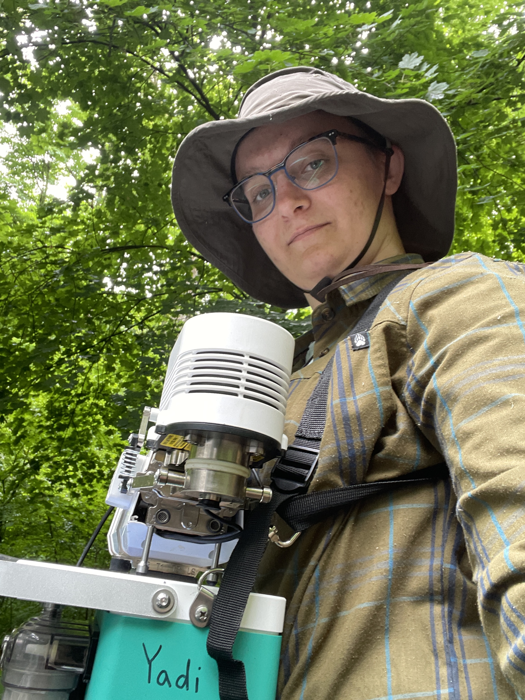
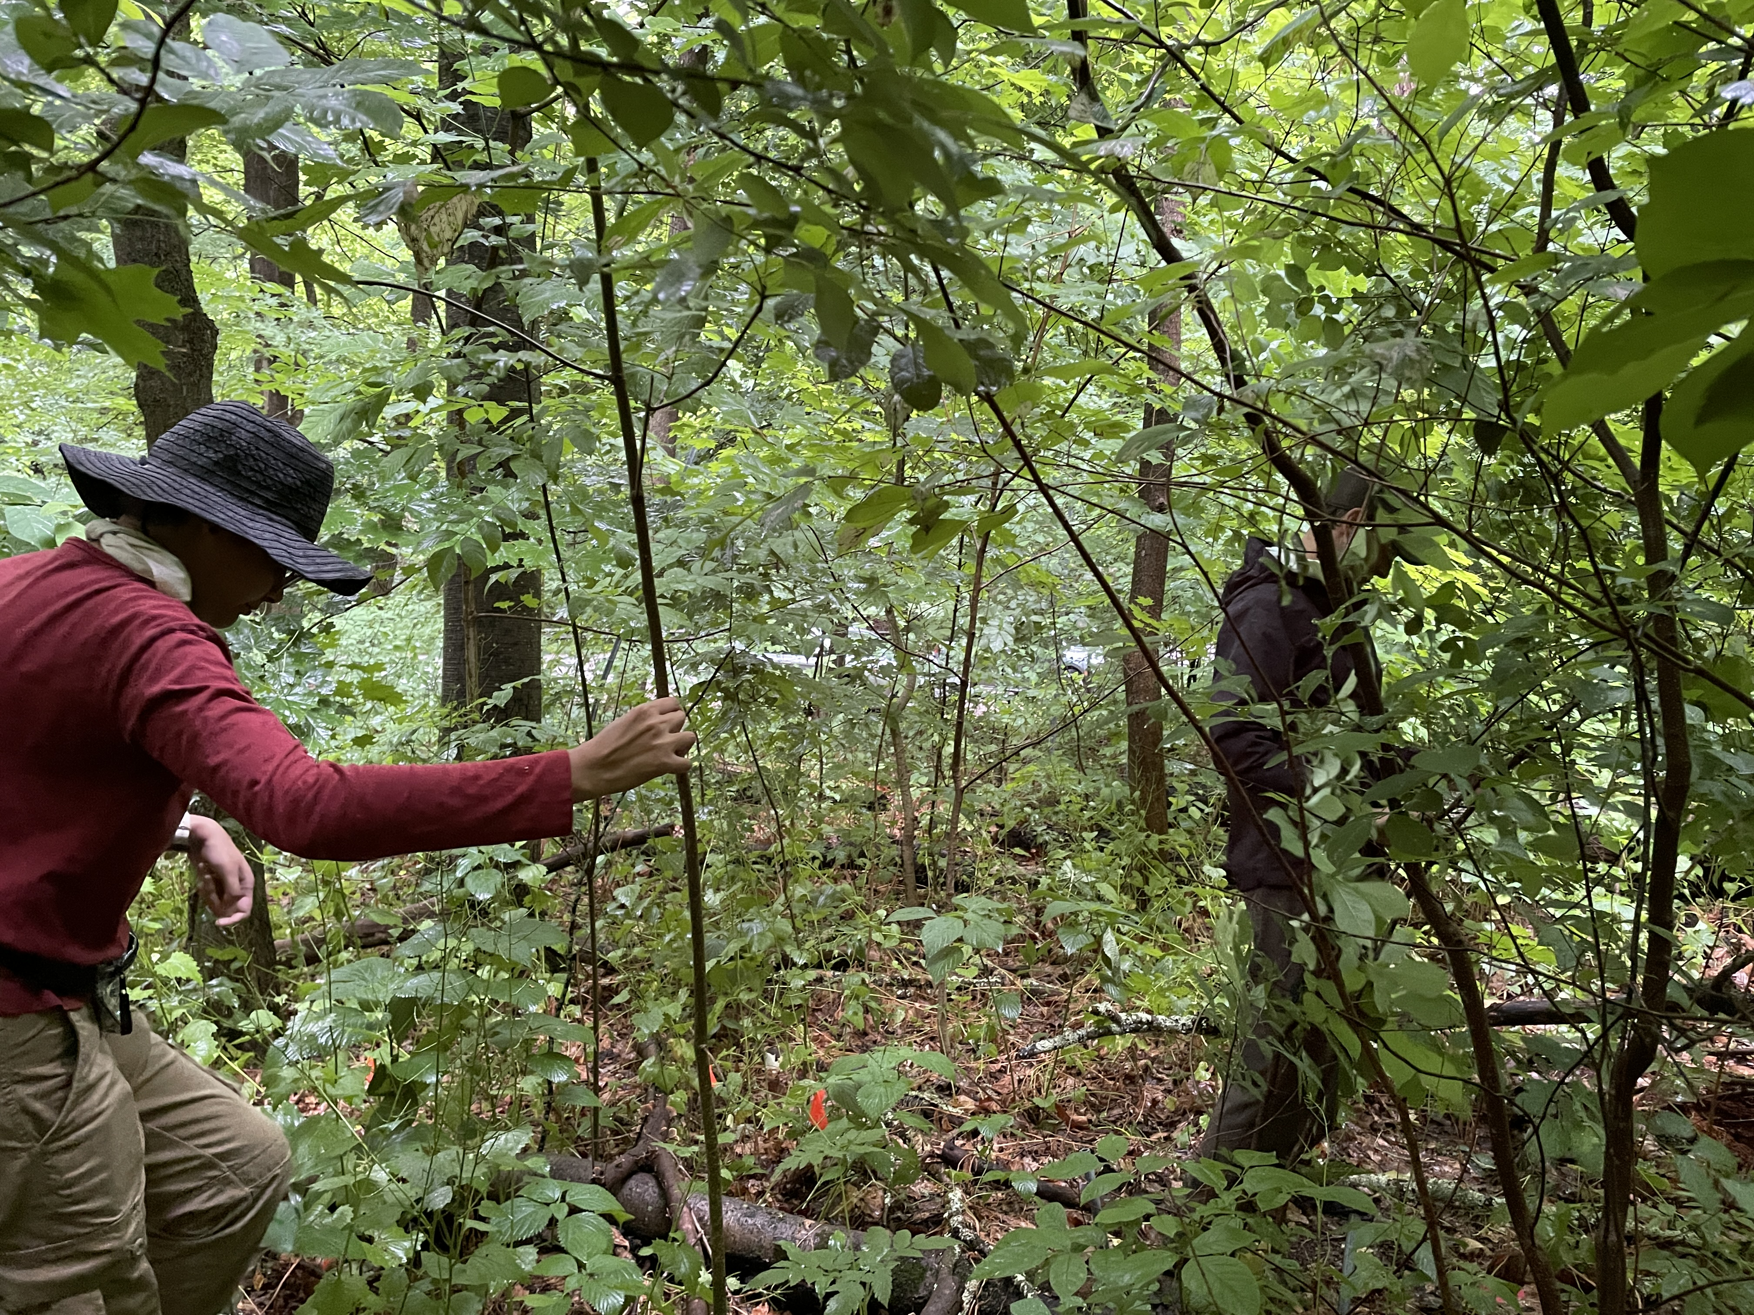
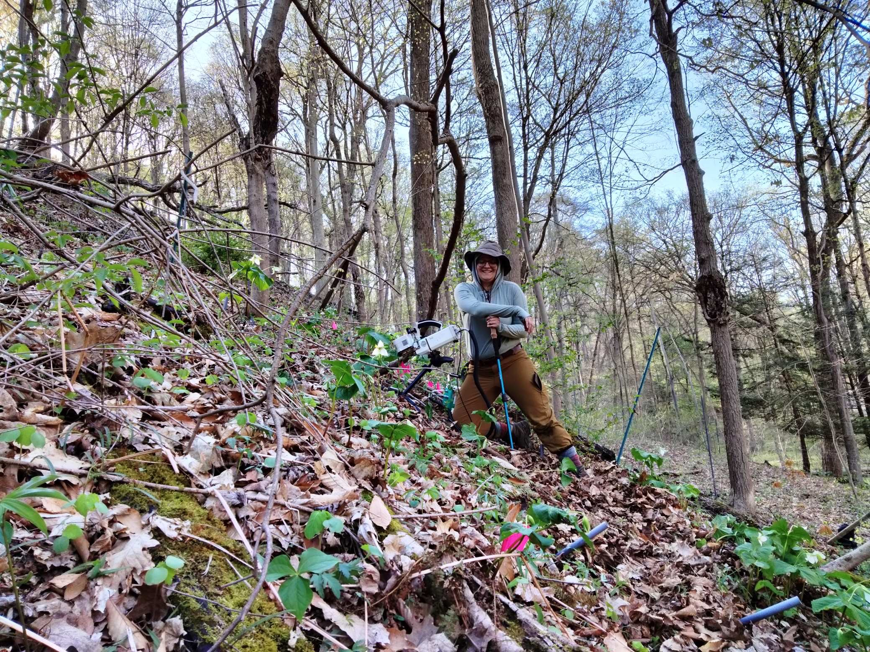
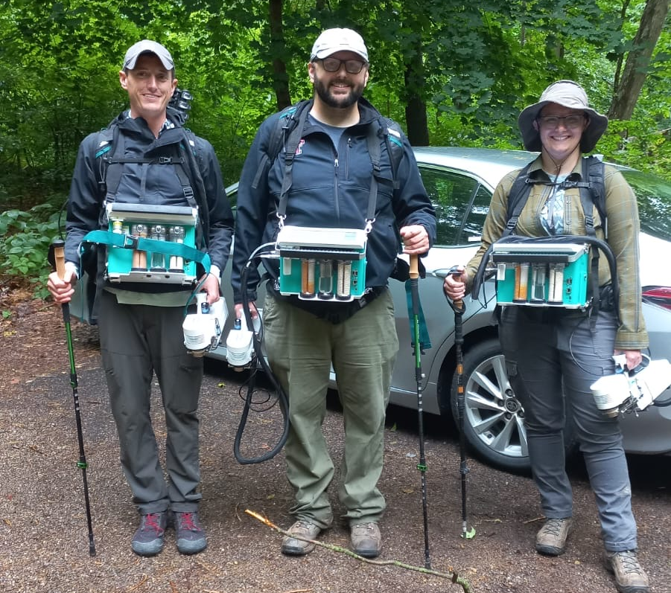
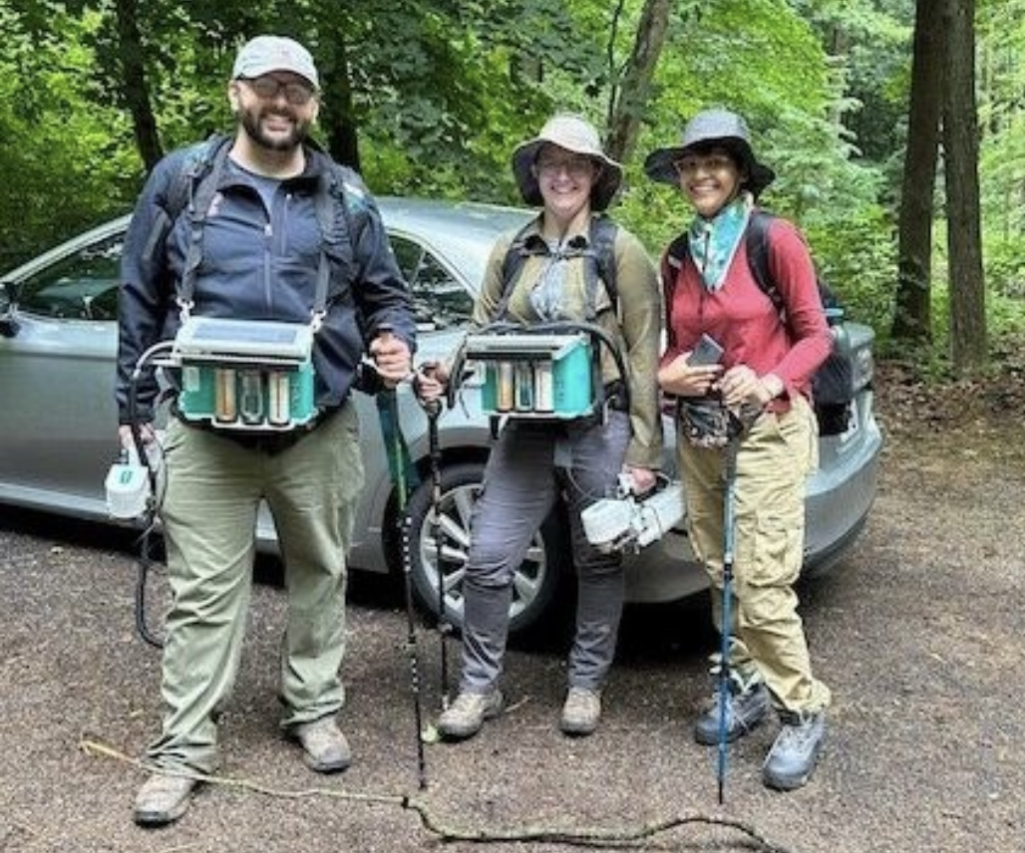

Applause please!
@EvanPerkowski

